Slide 1
Deferred rendering, part 1

Slide 2
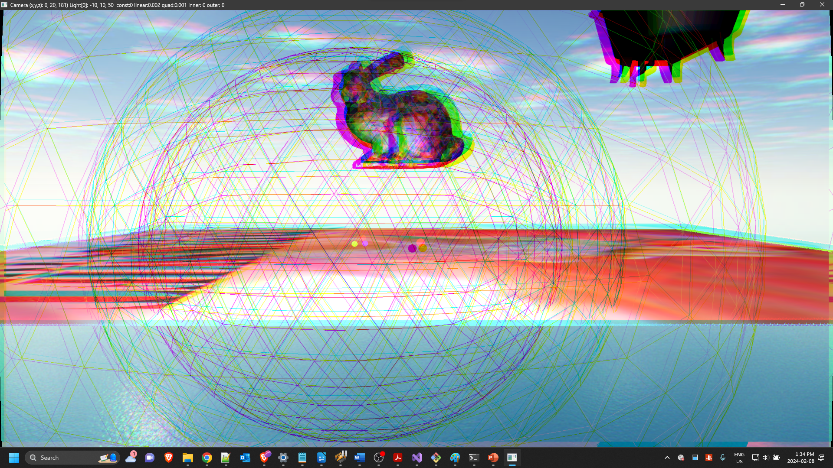
We are sampling separate colours just offset from where we are “supposed” to sample. The more “offset” we are, the greater the effect.
BLUE
UV
GREEN
RED

Slide 3
Basic “blur” is taking samples from adjacent pixels and averaging them…
UV
UV
UV
UV
UV

Slide 4
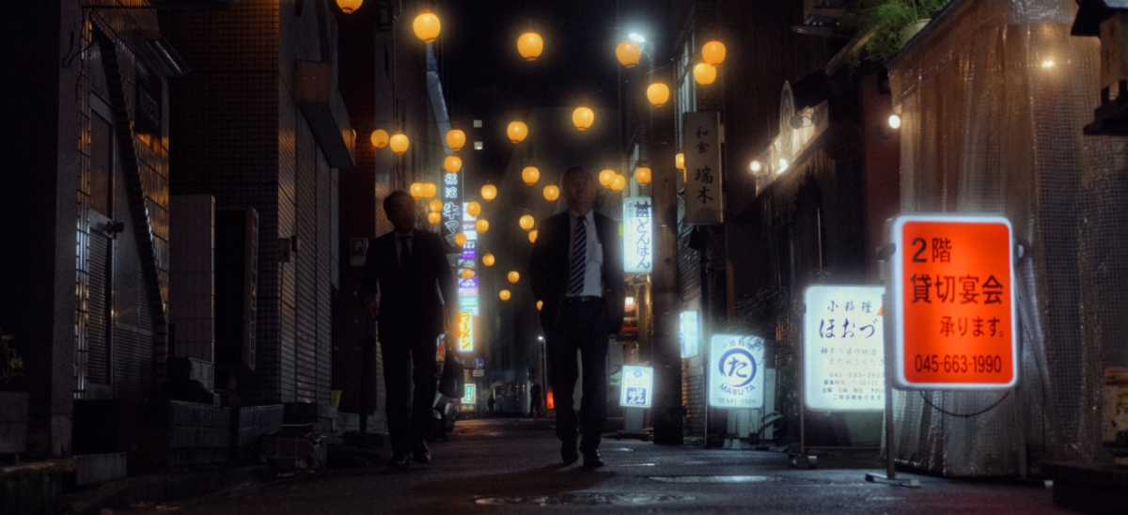
https://dehancer.files.wordpress.com/2020/05/bloom2-1.jpg?w=1200

Slide 5
Scene
FBO (regular scene)
FBO #2 : only write a grey-scale black to white brightness of the “lights” – NOT the actual light pass, but drawing the objects that you are using as “lights”

Slide 6
FBO (regular scene)
Samples the colour from the scene and then uses the “colour” from the bottom (lights) to blur that pixel.
Scene
FBO #2 : only write a grey-scale black to white brightness of the “lights” – NOT the actual light pass, but drawing the objects that you are using as “lights”

Slide 7

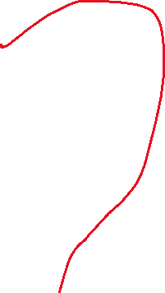
FBO
Color buffer (2D Array)
Depth buffer (2D Array)
Color buffer (2D Array)
RGBA8
(8 bits/pixel = 32 bits)
Render an object with the FBO as the texture
OpenGL
Depth buffer (2D Array)
(common depth = 24 bits)
(stencil = 8 bit)

